Slide 1
IMPACT OF REMOTE WORK ON MENTAL HEALTH POWER BI DASHBOARD

Slide 2
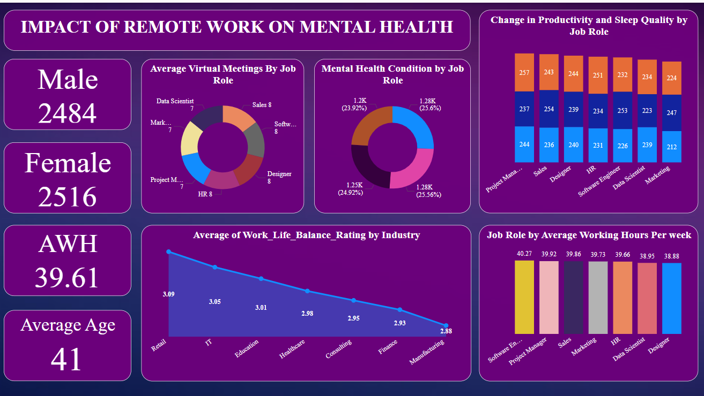
DASHBOARD

Slide 3
OVERVIEW OF THE DASHBOARD
Developed an interactive dashboard with the help of raw data.
Imported data from CSV file to Power BI Desktop.
Cleaned and organised the data and removed the duplicate values for a better view and understanding.
Explained actionable insights to the stake holders and company officials.

Slide 4
KEY INSIGHTS
Average working hours of the employees are 39.61.
Sales employees are having the highest virtual meetings.
Retail employees has the best work life balance and manufacturing employees has the worst.
Average age of employees is 41.
Software Engineers has the longest working hours of 40.27 hours per week and HR employees has lowest of 39.66 hours per week.
Project managers has the highest productivity changes.
Majority of employees mental health condition is burned out of 25.6%.

